Slide 1
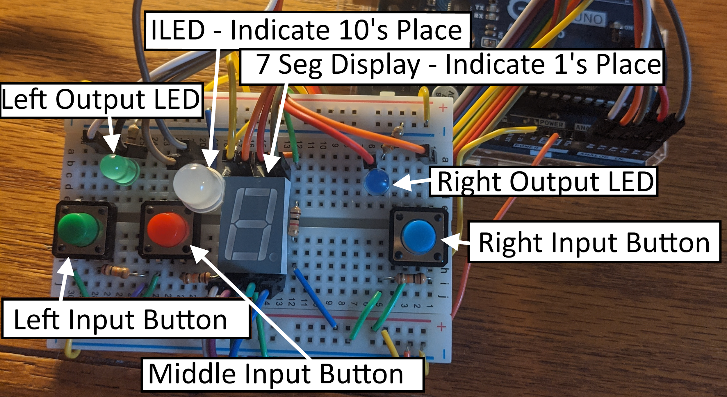
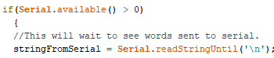
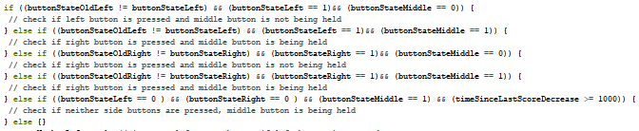
Two Player Scoreboard
CSE 1012 µC & Sensors Spring 2020
Problem: How might I keep track of two scores to see which side wins?
BREADBOARD SET-UP
Getting Input from Serial Monitor
Logic to Determine Which Buttons are Pressed
Features: Two scores and a maximum score are displayed using an ILED for the tens place and the 7-segment LED for the ones place. The colors of the rainbow represent each color on the ILED (Red = 1, Orange = 2, etc) Each score (left and right) can be increased or decreased with the buttons. The maximum score can be displayed. Each of the three scores can be changed from Serial Monitor. The code uses Adafruit_NeoPixel, SevSeg, and the math libraries.
Notes:
Instructions: Add a project name, problem statement, images or screenshots (e.g., Arduino set-up and code snippet - add labels added using the Insert > Text box command in google slides, arrows, etc), and a list of features. Please do not change the font type or size. Under Features include special things that the project has incorporated in it. When you are done, download as a Microsoft Powerpoint file and upload that to Canvas.

